Slide 1



‘’My Cup
less SUP‘’
video
concept
team
canvas
app
problems
WELCOME !

Slide 2
1
2
3
concept
16 Billion
Coffee Cups Globally Per Year
1 Million
Coffee Cups Per Day in Greece
video
team
canvas
app
problems
0,25% recycling

Slide 3
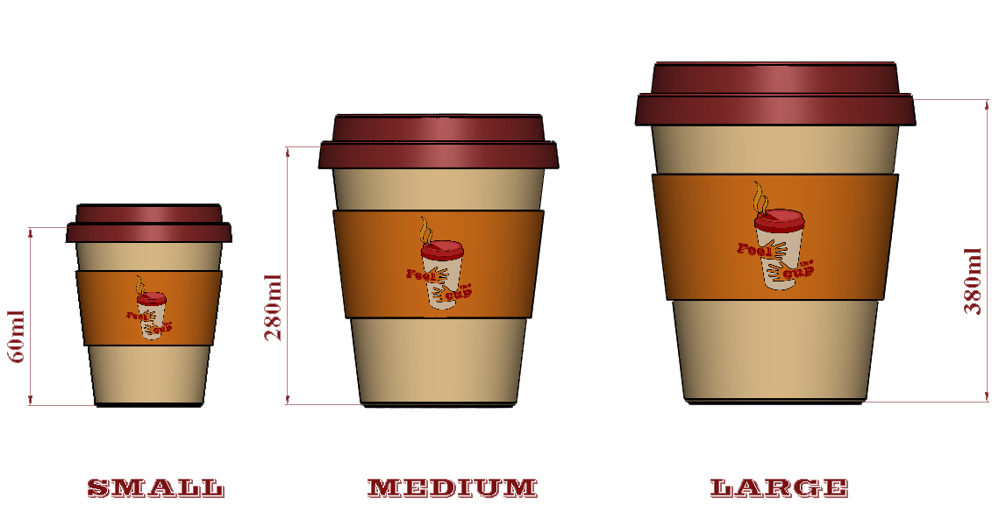
video
concept
team
canvas
app
problems

Slide 4

video
concept
team
canvas
app
problems

Slide 5
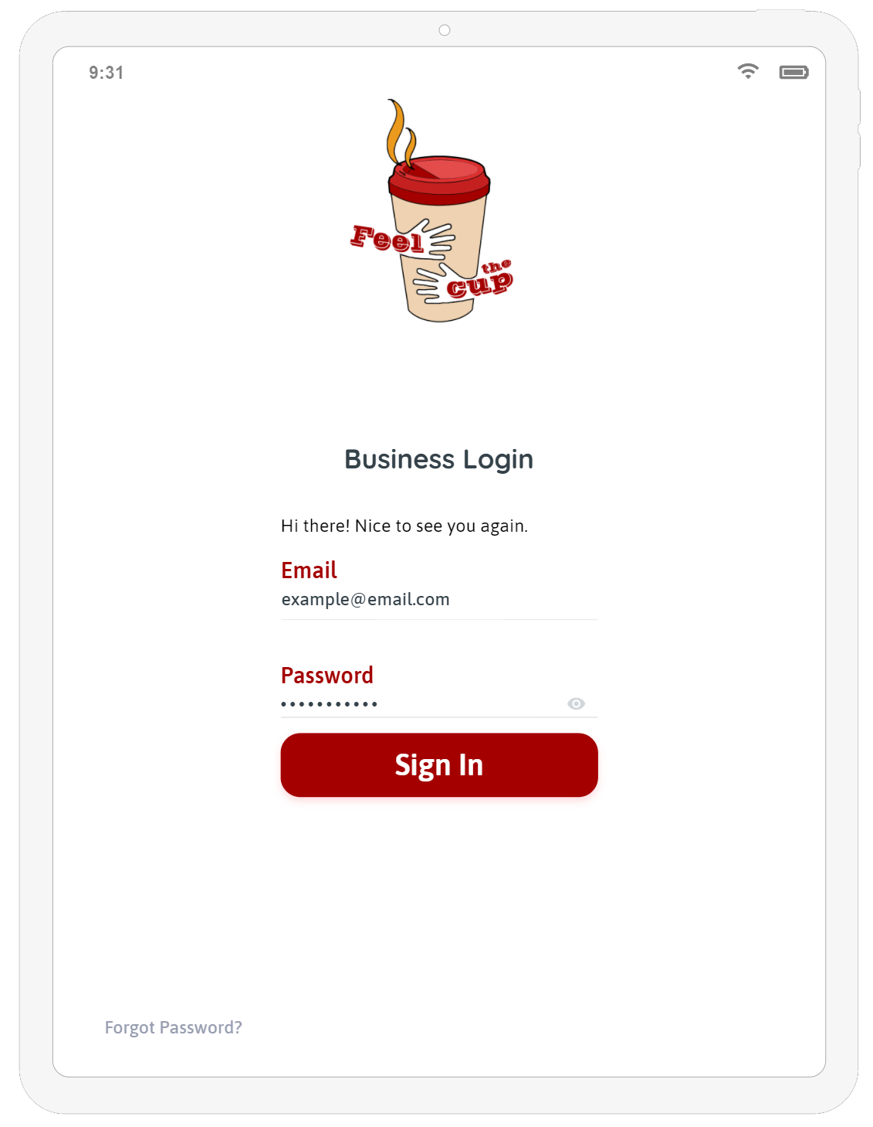
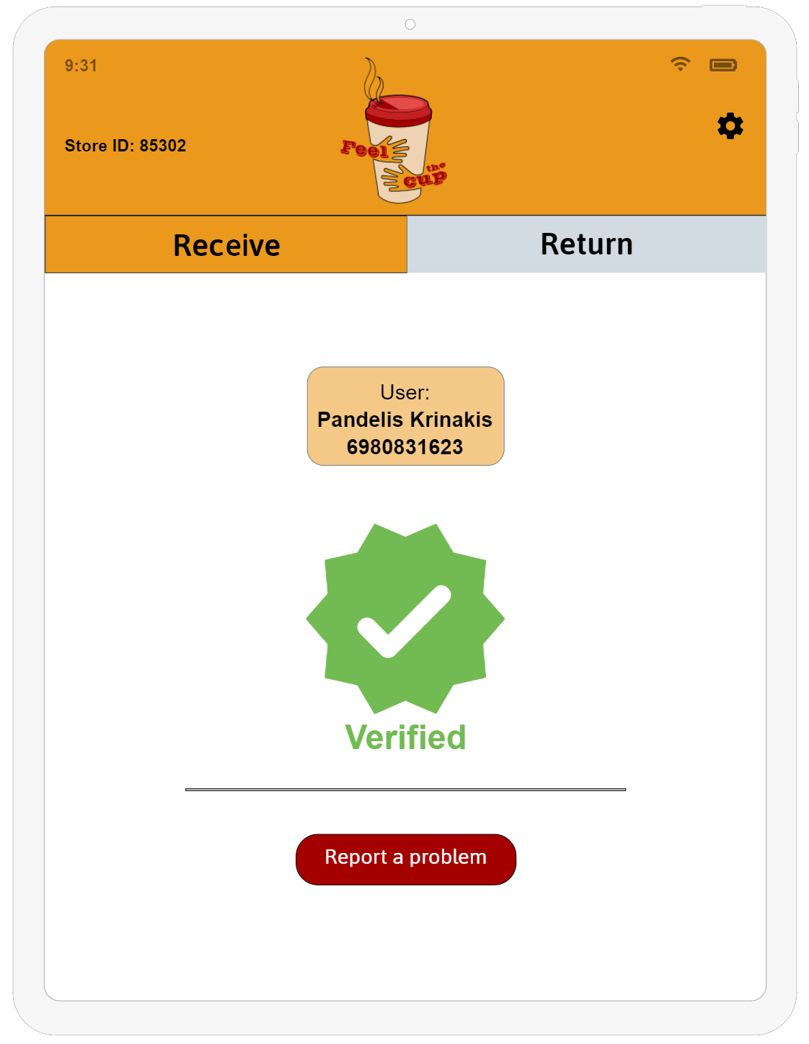
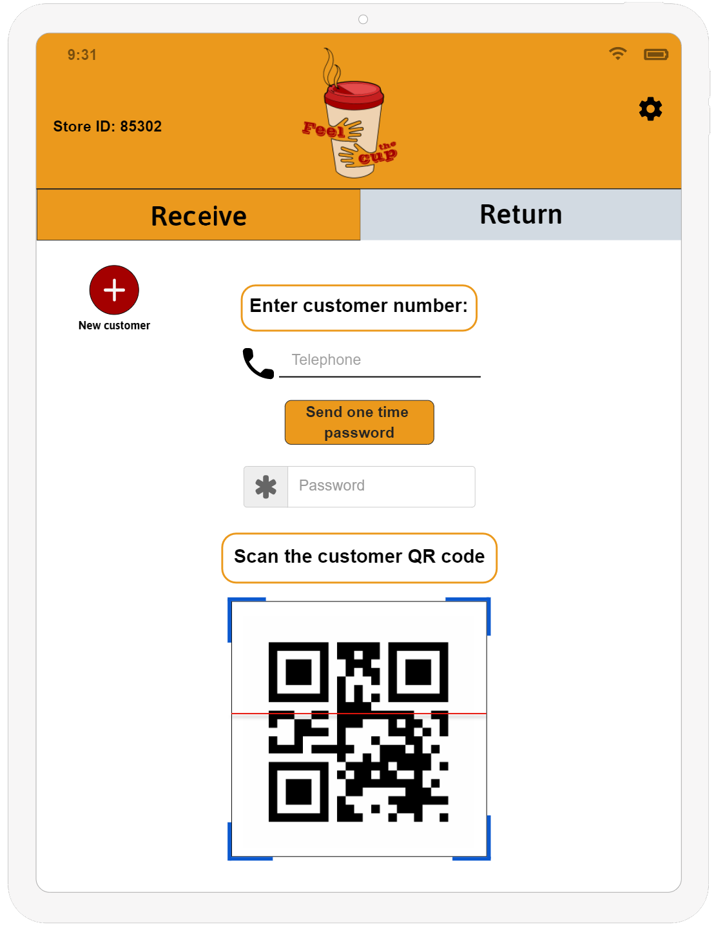
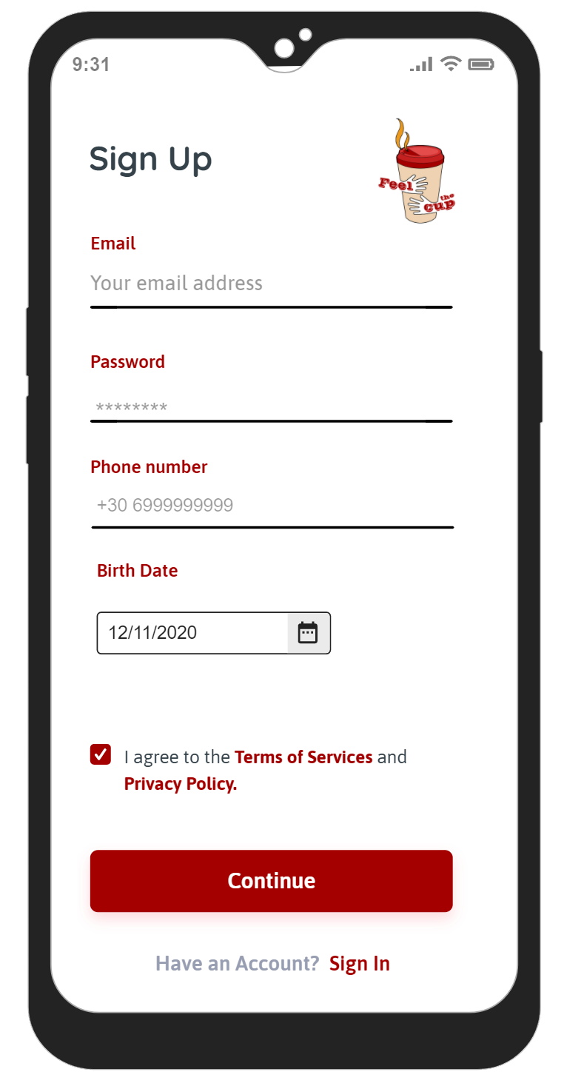
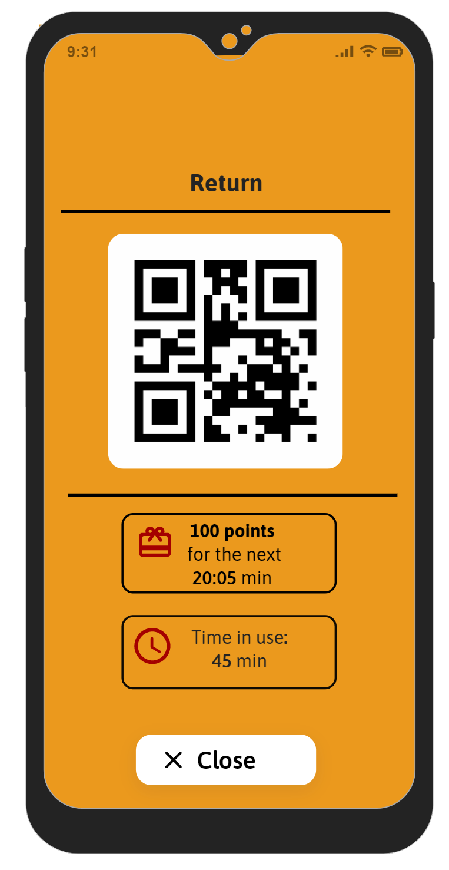
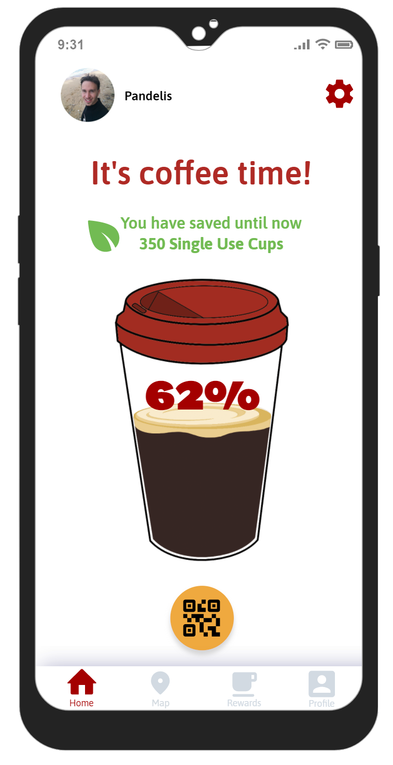
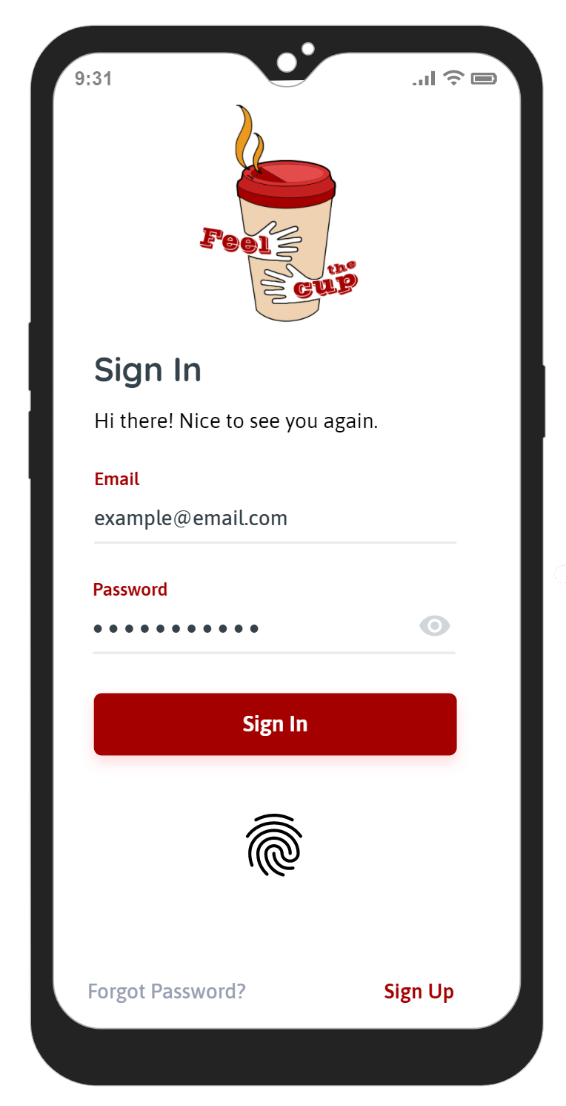
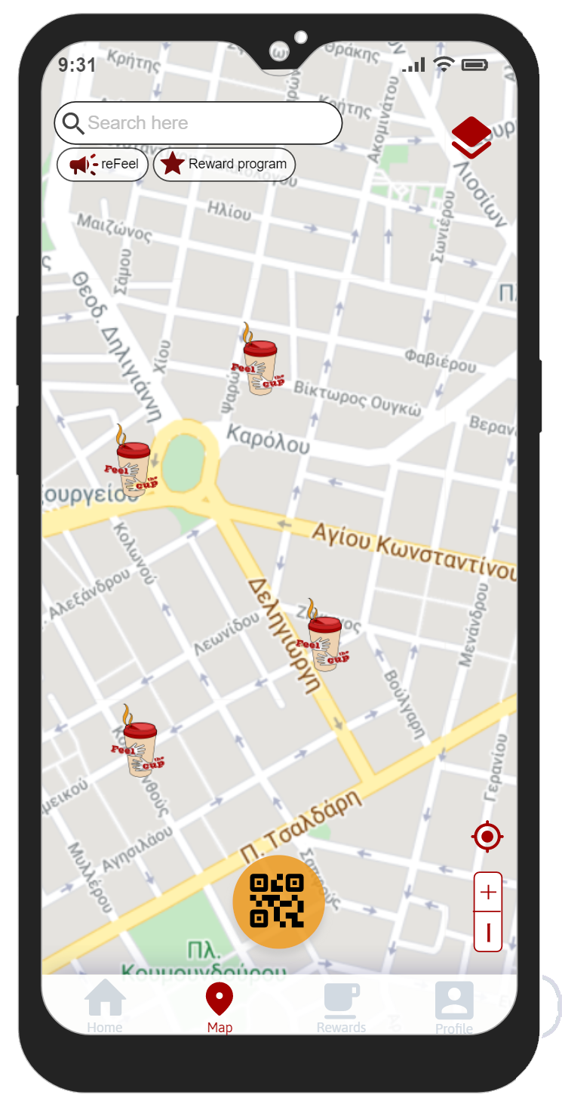
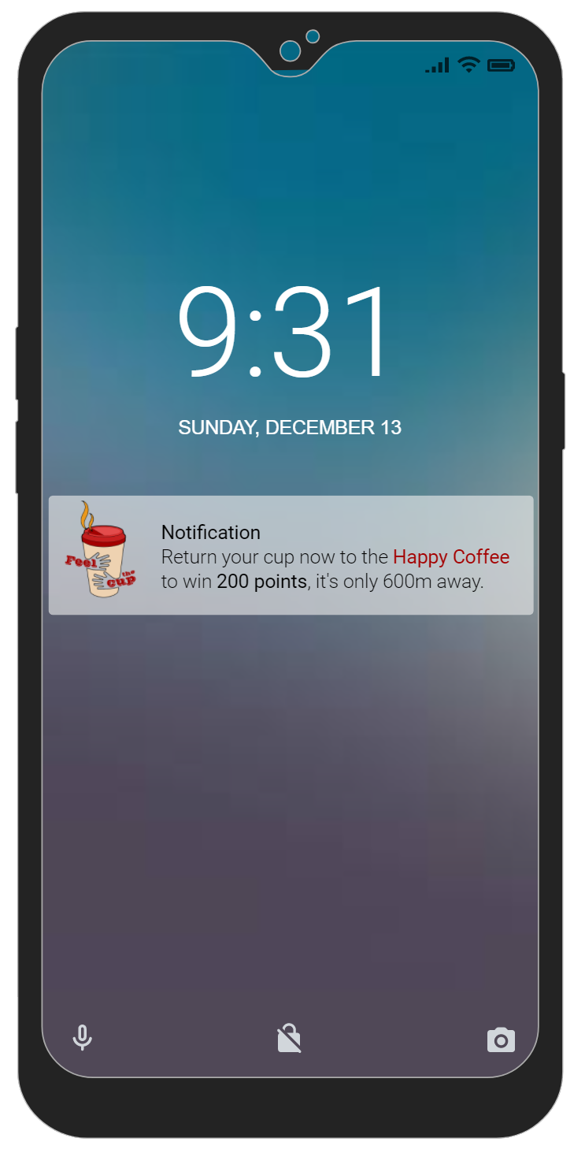
video
concept
team
canvas
app
problems

Slide 6
Customer relationships
Key activities
Key partners
Value propositions
incentives provided through our pricing policy
App development
Net with coffee shops
Customer segments
Cups company
Cup – washer Company
Positive impact on the environment
Clients Loyalty
Cost reduction
Coffee shops
Key resources
Channels
video
concept
team
canvas
Equipment
Hard & Soft skills
Capital
HR
app
problems
App
Site platform
Word of Mouth
Cost structure
Revenue streams
R & D
purchasing of equipment
marketing expenses
Enhance revenues from monthly subscription fees of coffee shops
Entry costs from clients

Slide 7
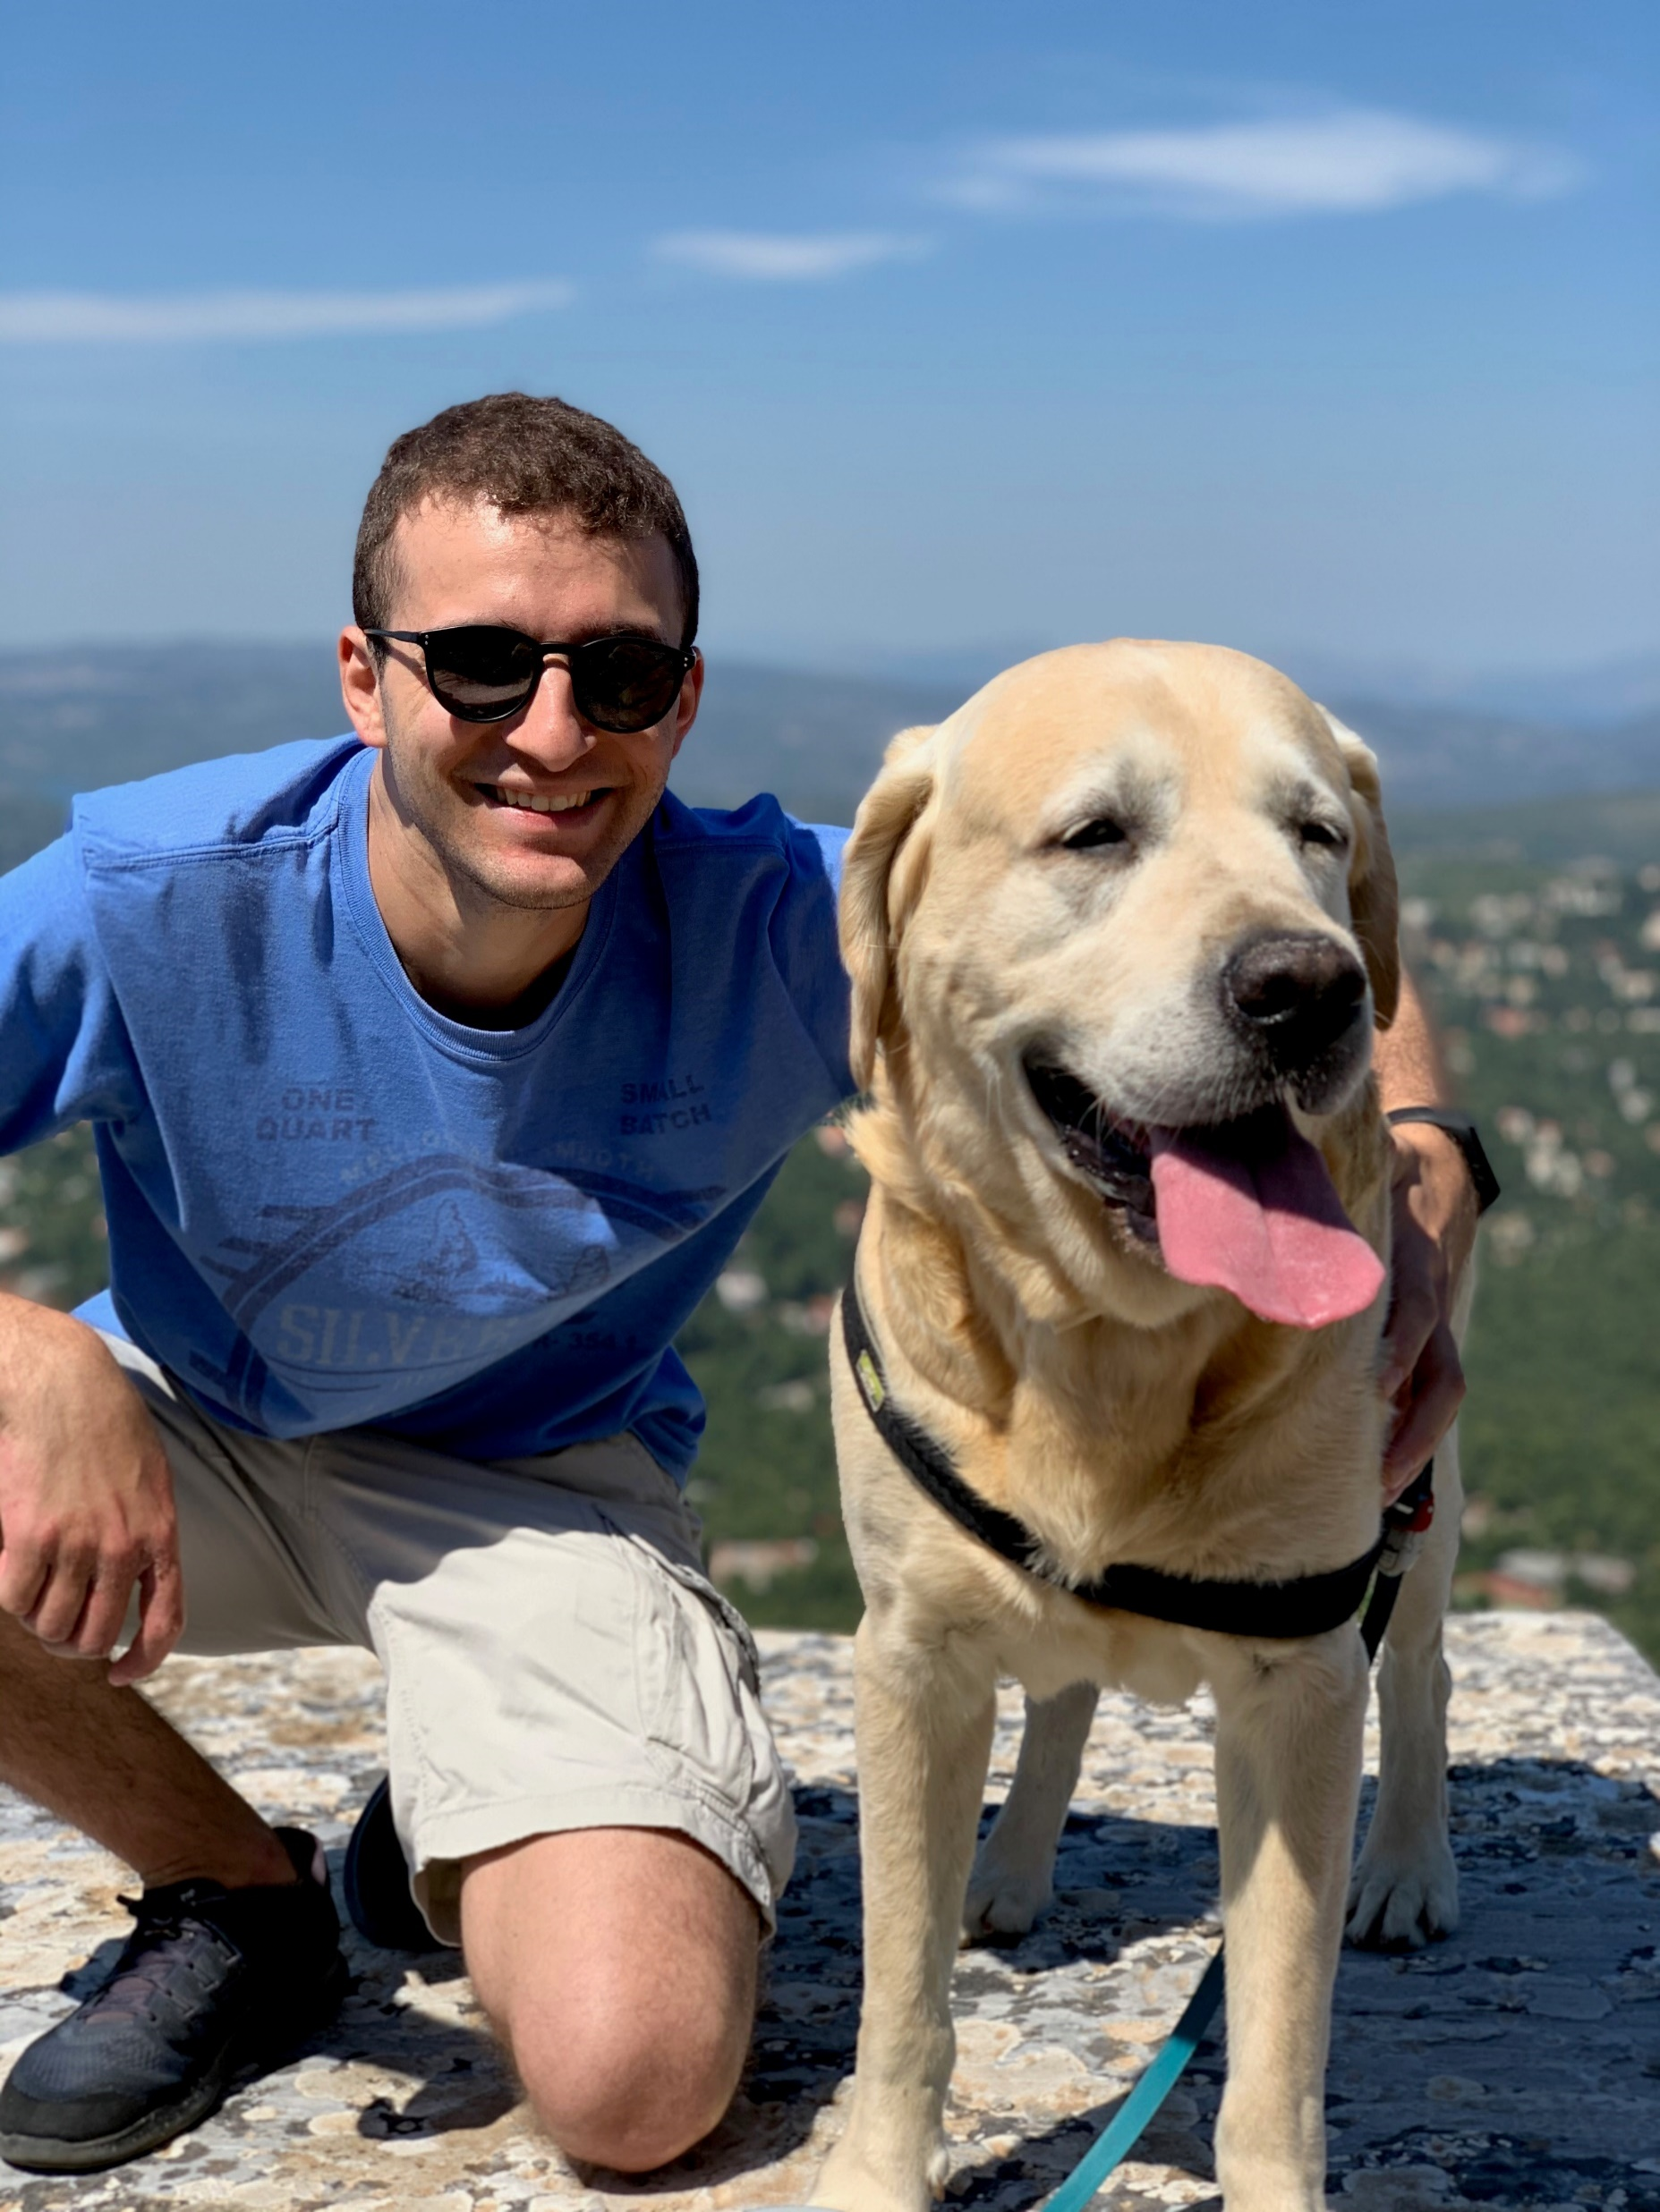

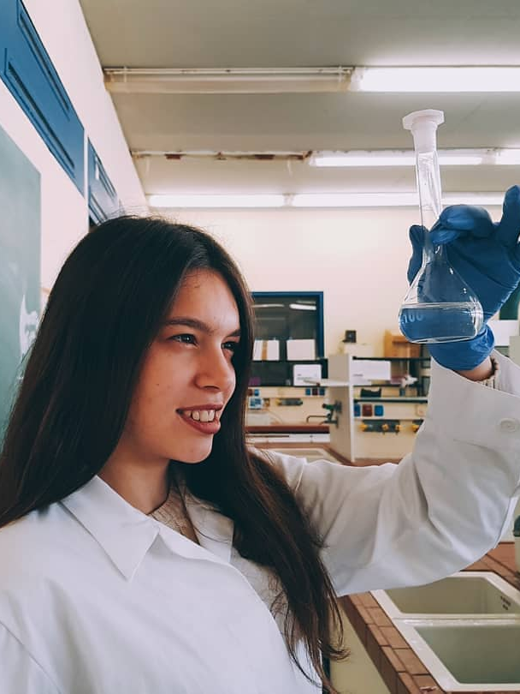


video
team
concept
canvas
app
problems
Marina Vlara
‘’The Scientist’’
Chemistry / NKUA
Marketing at ACG
Pandelis Krinakis
‘’The Tool’’
Product Engineering & Management / TUC
Alex Nikas
‘’The Hacker’’
MSc Information Security / UCL
Myriam Planaki
‘’The Marketing Guru’’
Marketing & Communication / AUEB
Aspa Vozikian
‘’The Engineer’’
Mechanical Engineering / NTUA

Slide 8
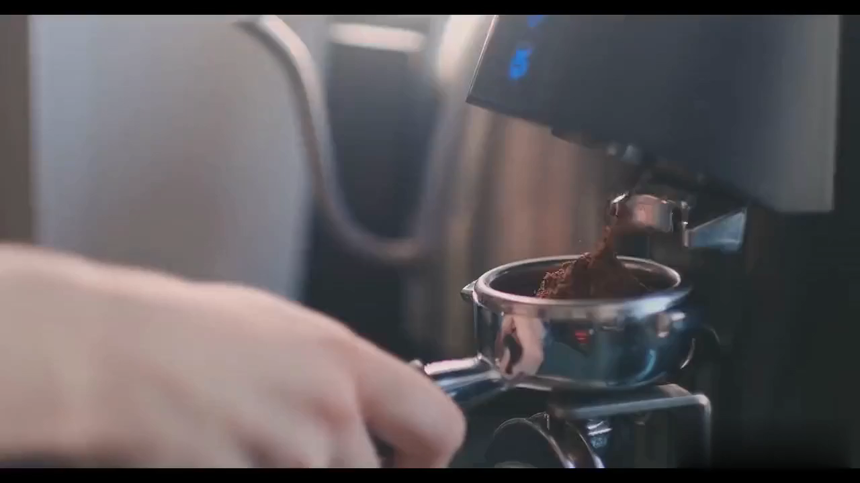
video
concept
team
canvas
app
problems

Slide 9
‘’My Cup
less SUP‘’
video
concept
team
canvas
app
problems
Thank you !

